Slide 1
Penn Biotech Group
Dhairya
University of Pennsylvania
2021-2022 Academic Year
Notes:
https://pennbiotechgroup.org/

Slide 2
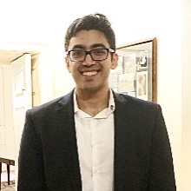
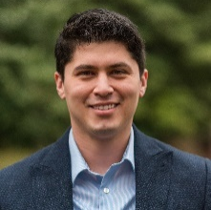

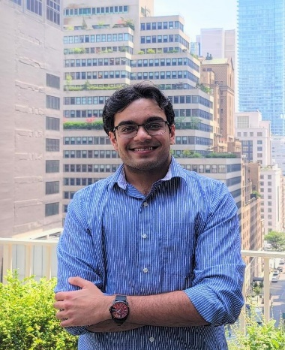
Presenting Team
Everyone
Varun Bahl
Ph.D. Candidate in Pharmacology
Daniel Jacome
Ph.D. Candidate in Pharmacology
Adrienne Jo
Ph.D. Candidate in Pharmacology
Dhairya Patel
Master of Biotechnology
VP Consulting
VP External Affairs
VP Operations
Co-President

Slide 3





Penn Biotech Group Mission Statement
Dhairya
“PBG is a cross-disciplinary, student-run graduate organization through Wharton School at the University of Pennsylvania that focuses on addressing the challenges and obstacles facing the life sciences industry today. Our multidisciplinary teams in the Healthcare Consulting Division have worked successfully for both Fortune 500 and start-up companies, consulting on real life projects from Strategy to Marketing, from Pricing to Revenue Modeling, and from Operations to IP.”
Industry Sponsors
Notes:
"Historically, more than half of our members pursue management consulting post graduation and find employment at McKinsey & Company, Boston Consulting Group, Bain & Company, L.E.K., ZS, IQVIA etc. "

Slide 4
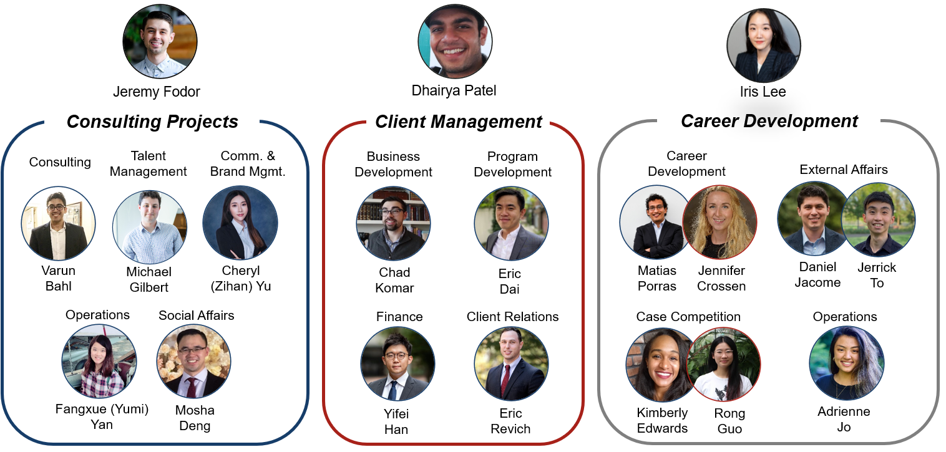
2021-2022 Penn Biotech Group (PBG) E-Board
Dhairya
4

Slide 5
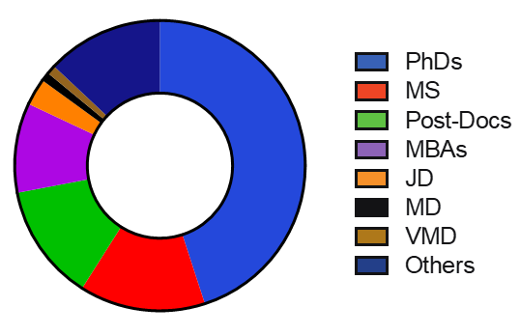
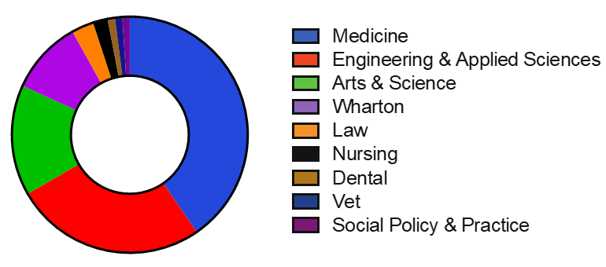
Who We Are: Penn Biotech Group is a student-run organization dedicated to preparing advanced degree candidates for careers in management consulting and finance
Dhairya
12+
PBG Infographics
The largest consulting club for non-MBA advanced degree candidates at Penn, with
years of history
13%
45%
10%
300+
Members actively participated with PBG per year
13%
14%
1200+
PBG alumni working in a variety of healthcare-related industries
3%
10%
40%
15%
9/12
We attracted students from schools at Penn*
26%
*based on statistics from Fall 2020 projects

Slide 6





Who We Are: A Range of Backgrounds and Expertise Areas
Adrienne
PBG attracts the brightest minds at Penn focused on solving existing healthcare needs. Our members have a set of core competencies in finding key intersections between science and business to effect progress and innovation for the biotechnology community
Penn Medicine
Penn Engineering
Wharton School
Penn Law
Arts and Sciences
Degrees
MD, PhD, MS, Postdoc
PhD, MSE, Postdoc
MBA, PhD
JD, ML
PhD, MS, Postdoc
CAR-T Cell Therapeutics
mRNA Therapeutics
Drug Design
Drug Delivery
Tissue Engineering
Nanotech Diagnostics
Strategy Consulting
Healthcare Economics
Healthcare PE/VC/IB
Healthcare Reimbursement
Ethics in Care Delivery
Healthcare Public Policy
Immunology
Disease Pathology
Computational Biology
Focus Areas

Slide 7
PBG members conduct pro bono consulting while expanding their consulting toolkit through internal and external educational opportunities
Varun
Pro bono consulting
Educational Opportunities
Conduct 30-40 consulting projects per year and serve clients in the extended healthcare industry, including pharma, MedTech, payers, startups and venture capital
Delivered 400+ projects in the past 11 years for organizations ranging from start-ups to Fortune 500 companies
Co-organize Penn-Stanford Healthcare Case Competition
  Previously known as Penn Healthcare Case Comp.
Historically, more than half of our members pursue management consulting post graduation and find employment at top consulting firms
  McKinsey & Company, Boston Consulting Group, Bain & Company, L.E.K., ZS, IQVIA, etc.
PBG entrepreneurship series with top innovators
Firm-hosted lecture programs honing strategy consulting and financial modeling skills of PBG project members
PBG-hosted consulting workshops educating members on providing high-quality deliverables
Case workshops and summer bootcamps
Healthcare-related career panels
PBG Alumni mentorship program matches PBG members with PBG alumni based off interests and career goals
External PBG project advisors staffed on each project
  McKinsey, Bain, BCG, ZS, L.E.K. incoming associate hires from Penn graduate programs
300+

Slide 8

Benefits of Consulting
Adrienne
Life as a Consultant:
Day-to-Day:
Problem Solving
Presentations/
Workshops
Reports
Interviews
Coaching
You will work in small and focused teams guided by project and client leaders
You will own meaningful parts of a project, helping clients achieve sustainable impact
You will be mentored and coached to help you develop your professional skills
What does this
mean for you?
Challenge of solving major business problems
Exposure to a range of industries and skills
Top management exposure
Working within teams to bring creative and rigorous solutions
Sponsored by McKinsey

Slide 9
PBG offers a positive, supportive learning environment to support your career
Varun
Supportive
Learning
Environment
Networking
Opportunities
Access to
Full-Time
Consultants
Positive
Past Member
Experience
Career
Development
Support
Develop your research, communication, and presentation skills
Learn from peers, PBG leadership, project advisors, and clients
Career workshops with full-time consulting professionals
Club happy hours and social events
Strong brand presence in major consulting and pharmaceutical firms, VCs, and broad connections in healthcare industry
In a member survey, 94% of project participants would recommend us to their friends or colleagues
Great resume builder!
Healthcare-related career panels
PBG Alumni mentorship program

Slide 10
PBG Healthcare Consulting: Team Hierarchy and Responsibilities
Varun
  Representative PBG team hierarchy
  Responsibilities for each position
  Provides oversight and guidance to multiple teams
Project Director
(2-3 Projects)
  Logistics oversight
  Team support
  Quality control
  Management coaching
Client logistics
Team logistics
Project scoping
Creating/assigning deliverables for TMs
Project Manager
(1 project)
Project Manager
(1 project)
Leads and manages the team
Lead data collection and analysis
Team Member
Team Member
Team Member
Team Member
Team Member
Team Member
Team Member
Team Member
Primary/Secondary Research
Data analysis
Deliverable production
Recommendation to client

Slide 11








PBG Consulting Projects
Varun
A start-up with a cloud-based software wants to understand the market, how their product fits in, and what they should consider in a future pricing structure
A medical device start-up wants to know how to best price their technology
A medical device start-up wants to update their pitch deck and needs to understand the need and concerns regarding their product from end-users
Few Past Clients
A large biotechnology client wants to understand deals occurring in the pharma-biotech industry and resources available/lacking to start-ups
A financial literacy firm wants to understand the market and consumer behavior
A mid-sized pharmaceutical company wants to know what biotech startups are worth investing in
A start-up with the ability to synthesize a dietary supplement requests a therapeutic overview and market research
A biotech company wants to understand the market and available treatments for a disease of interest, and considerations for pricing the therapy when it goes to market
A start-up wants input for the design and commercialization of an innovative line of protective gear for scientists

Slide 12
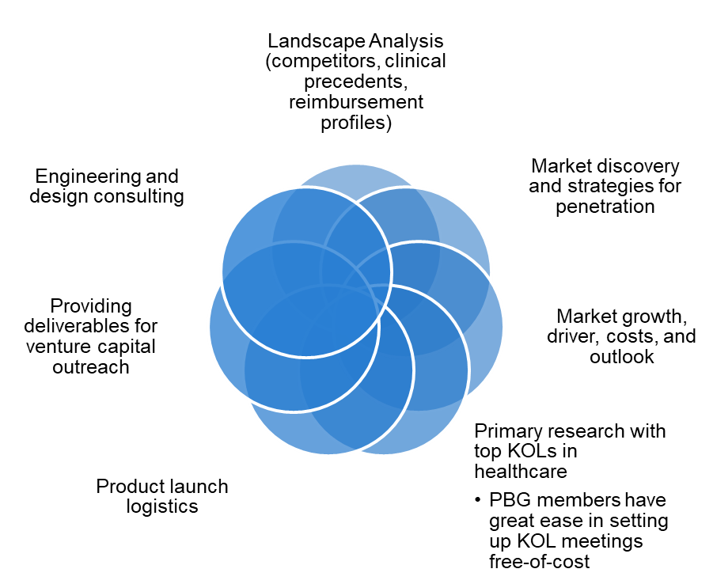
Project Engagement Overview
Dan
PBG Healthcare Consulting Services
PBG Healthcare Consulting Impact
Assisted in launches of over a dozen products
  Our members have real-world impact with their consulting services
Fostering the growth of future consulting leaders
  PBG is committed to rigorous training of its cohort through exposure to professional healthcare consulting akin to real world services
  Our members have a track record of remarkable career growth compared to colleagues from other institutions
Attracting top consulting firms for recruitment
PBG members are at the forefront for securing top employment opportunities in healthcare consulting roles

Slide 13
Select project example types completed this past year
Dan
Industry | Project Type
Biotechnology | Cost Analysis, Literature Search
Biotechnology | Product Development, Literature Search
Biotechnology | Business Plan, Strategic Planning
Immunotherapy | Start-up formation, Market Analysis, Financial Forecasting (NPVs, DCFs)
Software Management | Market Analysis, R&D Analysis
Non-Profit Bio | Market Analysis, Primary Research
Software | Market Research, Sales Strategy, Product Develop.
Medical Device | Market/Competitor Analysis, Finance Strategies
Core Facility | Market Analysis, Finance Strategy, Strat Planning
Non-Profit Med. Device | Market Analysis, Strategic Planning
Pharmaceuticals | Primary Research, Strategic Planning
Pharmaceuticals | Patient Solutions Strategy
Medical Device | Product Development, FDA regulations
*Note: This table is not an exhaustive list. PBG staffs 40+ projects for 300+ team members, project managers, project directors, and project advisors. Each engagement typically lasts 8-12 weeks and staffs 5-8 total members.

Slide 14
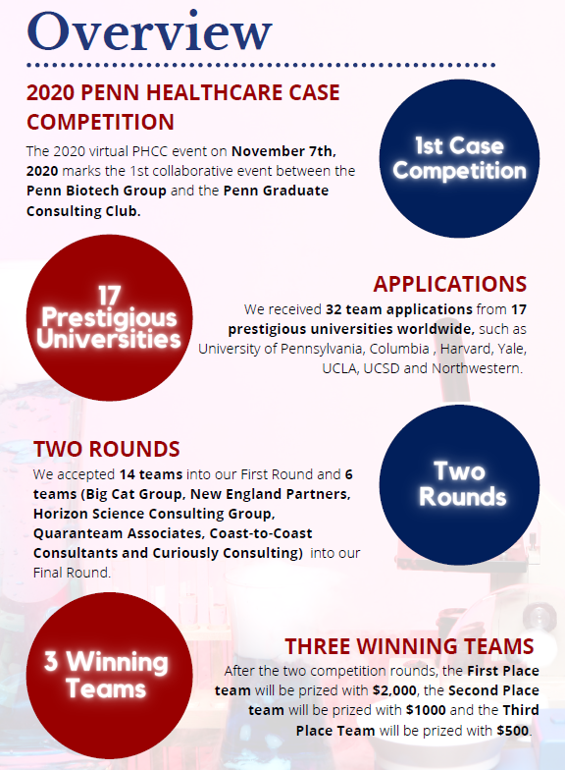
Healthcare Case Competition
Adrienne
Penn Healthcare Case Competition (2020)
Penn-Stanford Healthcare Case Competition (2021)
Collaboration with Stanford University to host a first-of-its-kind intercollegiate healthcare case competition
1st place: $6000
2nd place: $3000
3rd place: $1500
Expecting more than 50 team applications
Tentative date: November 13, 2021
Applications will open early October
Sponsors: McKinsey, Herspiegel, Axiom, ZS
Judges: Venture Capital, Consulting, Big Pharma

Slide 15
Example Case (mini-MBA) – Good Stent Company Acquisition
Dan
GSC: Medical device company
Client Questions
Technology: New generation of stent that can accommodate gene therapy vectors
1. How should GSC price the stent to maximize profit? What factors did you consider?
2. Who is the target market? Any replacements or substitutes?
Benefits: Increases stent life to 50 years and reduces bleeding risk
3. What are the risks by the buyer?
Status: passed clinical trials, ready to hit market,16 years of patent life
4. Metrics (ROI, NPV, etc.) and recommendation?
Item | Cost
Bare Stent | $200/unit
Tariffs & Taxes | $10/unit
Processing for gene therapy | $300/unit
Total | $510/unit

Slide 16
Example Approach – Validating Product Fit in Market
Dan
Gene Delivery Stents have the potential to introduce long-term cost savings to healthcare system and promote improved patient health with implants
Asset Evaluation Framework
Key Points
Unique Continuation-in-path
GDS manufacturing costs account for GMP-grade practices to yield a higher price per unit
Novel technology with potential to save payers reimbursement costs on follow-up surgeries
GDS adoption of continuation-in-part regulations to emulate DES product cycle
GDS adoption can greatly improve payer-provider cost dynamics over patient lifetime and successfully improve patient health with gene therapy mechanism
FDA-approved
Key Strategy Insights
Payer Lifetime Cost per pt.
Gene Delivering Stents
Replacement Latency
Gene Delivery Stent – Strengths and Innovation
Replacement Latency: GDS increases product lifespan by an additional 20 years due to efficacy and safety
MFGR Costs
Curtailing Thrombo-occlusions
Curtailing Thrombogenesis: Lower likelihood of blood clot formation and stent failure leading to restenosis
Competitive Advantage: GDS vector immobilization more robust than DES chemical drug immobilization – ensuring lengthened vector influence in preventing restenosis
Key Takeaway

Slide 17
Kick-off – Fall 2021
Dhairya
Sign up to become a PBG member to attend the Fall kick-off
Location and date TBD
Happy Hour
Many top firms attending as guests
Network with firms, alumni and other PBG members
Learn about new PBG projects for Fall 2021
Food and drinks

Slide 18

Join us and make a real impact on your career outcomes
Dhairya
Follow this website for instructions on how to sign up as a PBG Member
Contact us at info.pbgconsulting@gmail.com with any queries
Follow us on LinkedIn and on Instagram
  Join PBG and show it on your LinkedIn profile (recruiters notice it!)
Tune in to our Science to Suits podcast hosted by Daniel Jacome and Jerrick To
Industry Sponsors

